Slide 1

IME602: Probability and Statistics: MULTIVARIATE STATISTICS (02)
Raghu Nandan Sengupta
Department of Management Studies (DoMS)
Indian Institute of Technology Kanpur, INDIA

Slide 2
Canonical Correlation Coefficient
Hotelling (1935, 1936) may be credited for developing the technique of Canonical Correlation Analysis (CCA), where the author studied how arithmetic speed and arithmetic power are related to reading speed and reading power

Slide 3
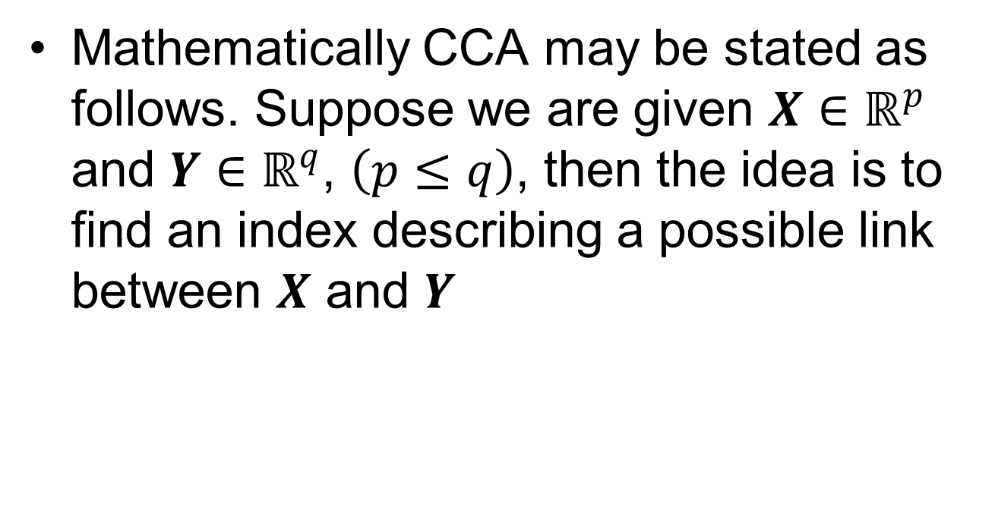
Canonical Correlation Coefficient (contd..)

Slide 4
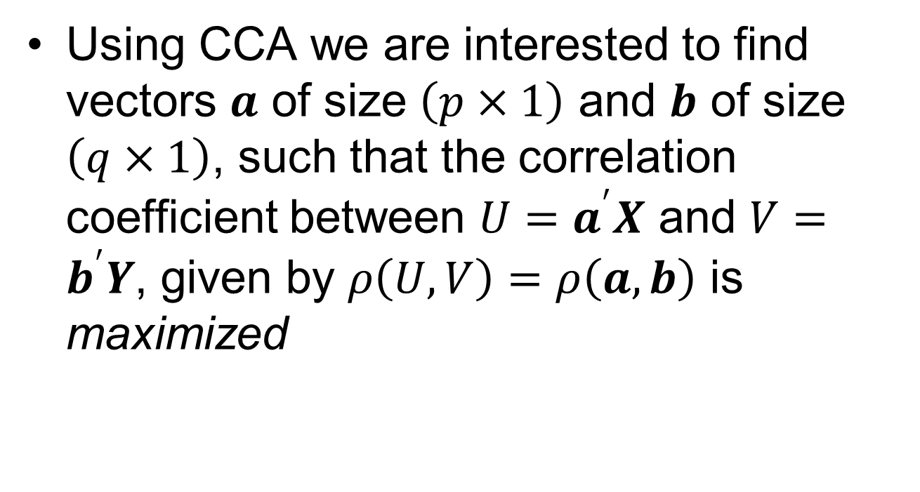
Canonical Correlation Coefficient (contd..)

Slide 5
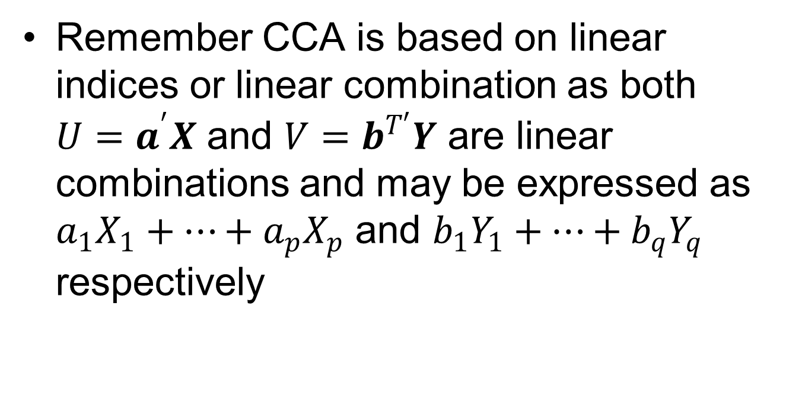
Canonical Correlation Coefficient (contd..)

Slide 6
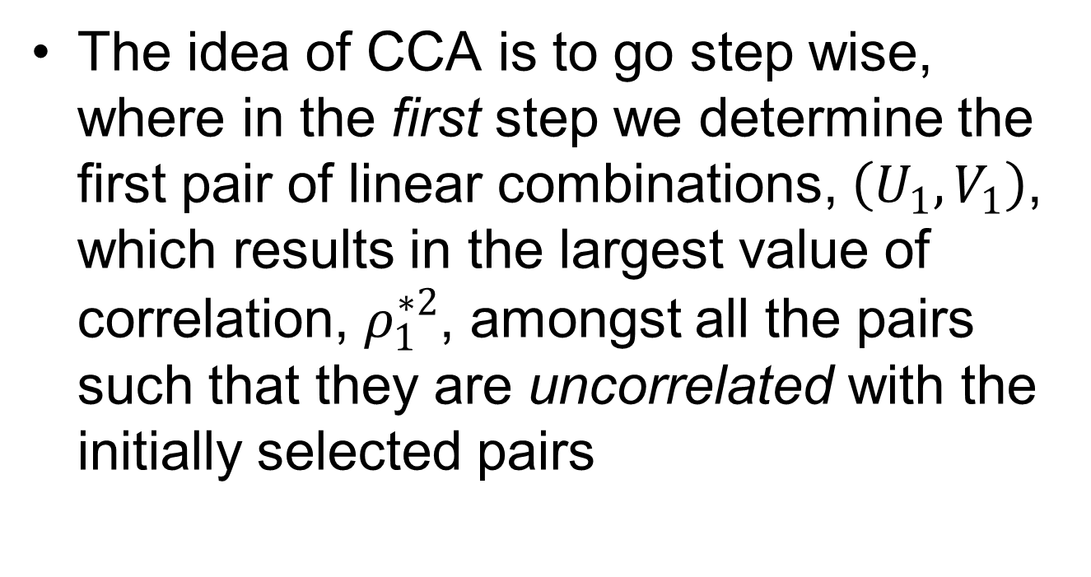
Canonical Correlation Coefficient (contd..)

Slide 7
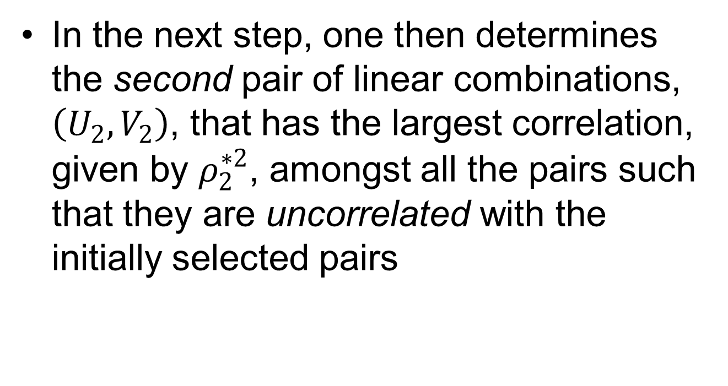
Canonical Correlation Coefficient (contd..)

Slide 8
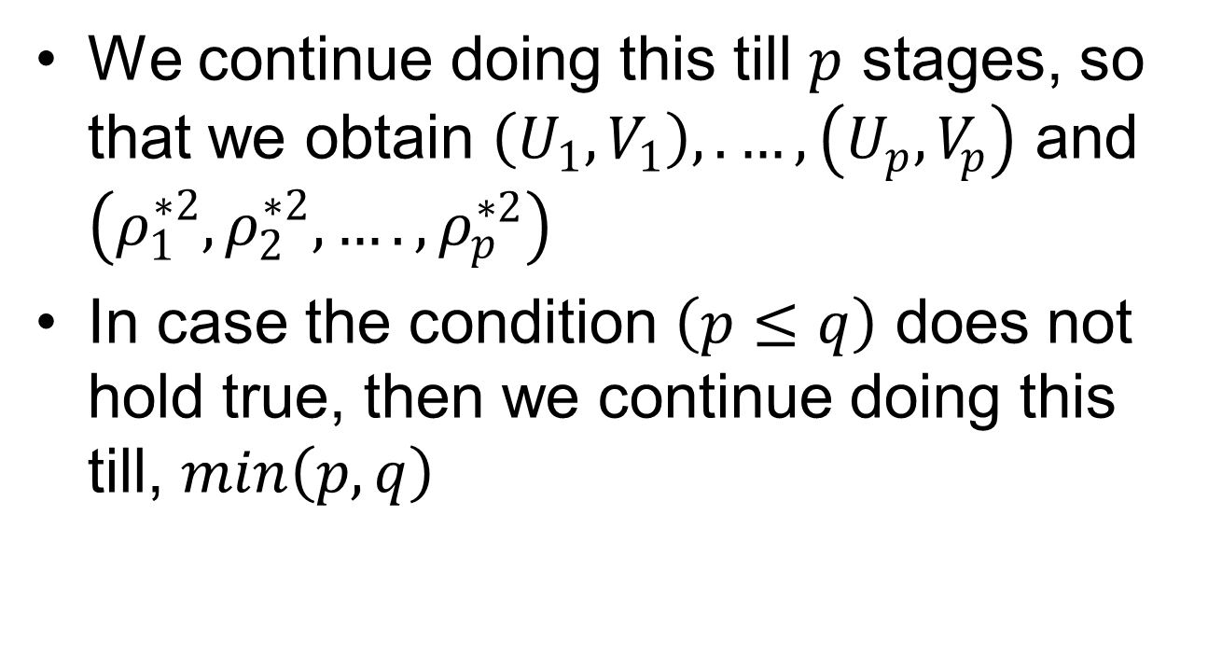
Canonical Correlation Coefficient (contd..)

Slide 9
Canonical Correlation Coefficient (contd..)
CCA is a simple and useful method to describe the correlation structure between two sets of variables
It is a generalization of the concept of multiple correlation and successively maximizes the correlation between appropriate pairs of linear combinations of the variables of the two sets

Slide 10
Canonical Correlation Coefficient (contd..)
The method can be viewed as a dimension reduction technique in that it represents the correlation structure between two sets of variables in terms of a smaller number of canonical correlations

Slide 11
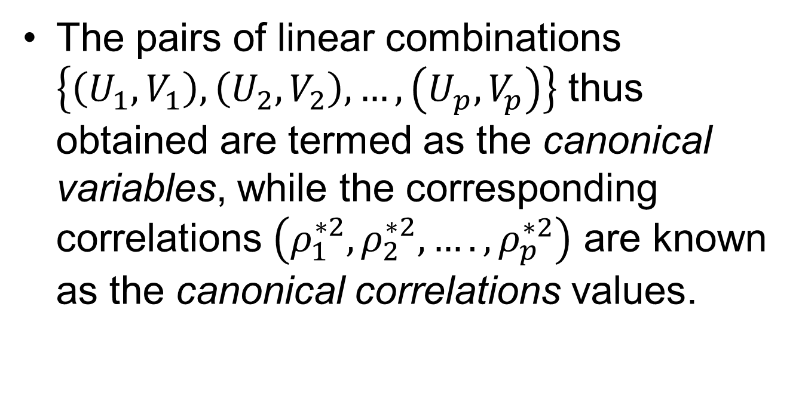
Canonical Correlation Coefficient (contd..)

Slide 12
Discriminant Analysis: Motivation
Example # 01: Consider a pediatrician has with her the data of height, age, sex, and age of children (in the age group of 2–5 years) from the past. Based on this information, a child is categorized as being obese, normal, or malnourished. When a new patient (in this case, a child) visits the pediatrician, then she, that is, the pediatrician, has to categorize the child as being in any one of the above-mentioned three categories, such that she can suggest medical care for the child as deemed appropriate

Slide 13
Discriminant Analysis: Motivation (contd….)
Example # 02: A musicologist is studying the composition written by composers between 1750 and 1820 AD (which is termed as the classical period of Western music). The musicologist is aware that a classification of the composer in that period may be made depending on the melody, rhythm, dynamics, mood, timbre, etc. When the musicologist is given a new piece or an unknown piece, then, depending on the characteristics of the musical piece, he/she may classify the musical piece as that belonging to Joseph Hayden, Wolfgang Amadeus Mozart, Ludwing van Beethoven, etc

Slide 14
Discriminant Analysis: Motivation (contd….)
Example # 03: A geologist classifies rock as igneous, sedimentary, or metamorphic, depending on its chemical composition, physical properties, texture of its constituent particles, and permeability. Suppose the geologist is given a new sample of rock, and is told to classify the given sample, then he/she may do so as desired using MDCA

Slide 15
Discriminant Analysis: Motivation (contd….)
Example # 04: You as a credit risk analyst are first interested to discriminate a company as good, average, or bankrupt, depending on price to earning ratio, amount of liability, and price of stock. After having done that, you study the credentials of different new companies and classify them as belonging to any one of the categories as already decided

Slide 16
Discriminant Analysis: Steps
Step # 1 (Separation/discrimination rule): In this step/rule, describe an algebraic or graphical rule such that one is able to differentiate observations/objects into different classes, depending on different characteristics/features, which are inherent in the observations/objects
Step # 2 (Allocation/classification rule): Once the first step is over, our next job is to sort out the new observations/objects into one of these classes depending on some logic/rule

Slide 17
Discriminant Analysis: Applicability
The MDCA method is appropriate when the dependent variable is categorical, while the independent variables are metric
MDCA derives the variate that best distinguishes between a priori groups
MDCA sets variate’s weights to maximize between-group variance relative to within-group variance

Slide 18
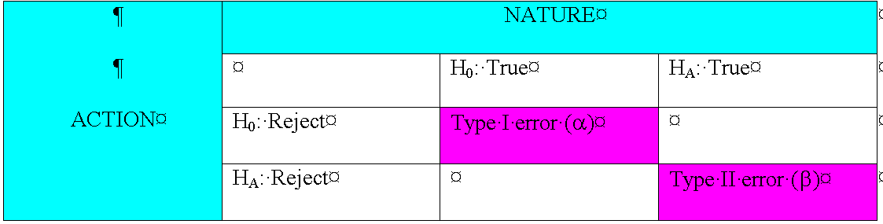
Discriminant Analysis: Caution

Slide 19
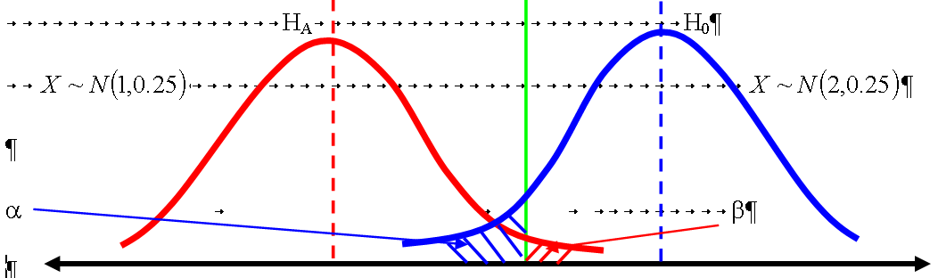
Discriminant Analysis: Caution (Contd….)

Slide 20
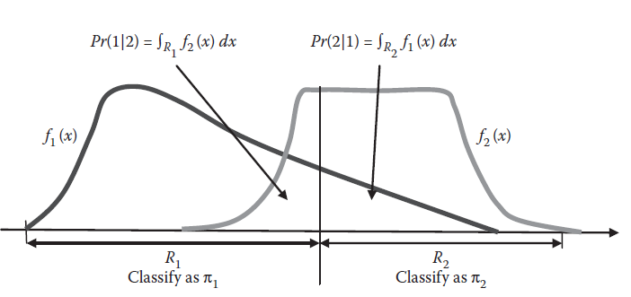
Discriminant Analysis: Caution (Contd….)

Slide 21
Discriminant Analysis: Example # 01 (More) (contd….)
Family income (X Rs. 10³)/ Apartment size (own) (ft²)), here n₁=12
90.0 (1840) 115.5 (1680)
94.8 (2160) 91.5 (2080)
117.0 (2360) 140.1 (1920)
138.0 (1760) 112.8 (2240)
99.0 (2000) 123.0 (2080)
81.0 (2200) 111.0 (2000)

Slide 22
Discriminant Analysis: Example # 01 (More) (contd….)
Family income (X Rs. 10³)/ Apartment size (rented) (ft²)), here n₁=12
105.0 (1960) 82.8 (2080)
94.8 (1720) 73.2 (2040)
114.0 (1760) 79.2 (1760)
89.4 (1600) 96.0 (1840)
77.4 (1640) 63.0 (1880)
81.0 (1400) 93.0 (1480)

Slide 23
Discriminant Analysis: Rules
Max: (Square of the differences between sample means)/(Sample Variance from whose perspective you are comparing)
Also find the errors: Observations in Class # 01 (Class # 02) greater/less than mean of Class # 01 (Class # 02), i.e., it should give you misclassification error, i.e., of Type I or Type II or BOTH, but there is a problem here

Slide 24
Cluster Analysis: Definition
Cluster analysis (CA) is a statistical technique whereby we form clusters/groups of similar individuals/objects using data/information from individuals/objects
This statistical method develops tools and methods, where given a data matrix, X_{mxn}, consisting of m number of individuals/objects where each of these m individuals/objectives are of dimension n, our aim is to build some natural subgroups or clusters of these individuals/objects

Slide 25
Cluster Analysis: Background
Using CA, we try to find some similarity or patterns in the data, for example, classification of plants/animals using taxonomy, diseases using epidemiology, etc
From a historical perspective, the origin of CA may be traced back to the work of Driver and Kroeber (1932) in anthropology, and later on, it was used in psychology (Cattell, 1943, Tryon, 1939, Zubin, 1938)

Slide 26
Cluster Analysis: Background (contd…)
Cluster analysis has been used in a variety of fields ranging from anthropology, agriculture, economics, psychology, geophysics, psychiatry, sociology, marketing, finance, behavioral sciences, different fields of engineering, etc
Good references with interesting applications can be found in Gordon (1981) and Hartigan (1975), Anderberg (1973), Duda et al. (2001), Duran and Odell (1974), Everitt and Dunn (2001), Gordon (1981), Hartigan (1975), Jain and Dubes (1988), Kaufman and Rousseeuw (2005), Späth (1980), Xu and Wunsch (2008)
Some other mathematical technique methods similar to cluster analysis are pattern recognition, numerical taxonomy, morphometrics, etc

Slide 27
Cluster Analysis: Idea
CA is a set of tools for building groups (clusters) from multivariate data objects
CA aims to construct groups with homogeneous properties out of heterogeneous large samples
The groups or clusters should be as homogeneous as possible and the differences among the various groups as large as possible

Slide 28
Cluster Analysis: Fundamental Steps
Cluster analysis can be divided into two fundamental steps.
  Choice of a proximity measure: One checks each pair of observations (objects) for the similarity of their values. A similarity (proximity) measure is defined to measure the “closeness” of the objects. The “closer” they are, the more homogeneous they are
  Choice of group-building algorithm: On the basis of the proximity measures the objects assigned to groups so that differences between groups become large and observations in a group become as close as possible

Slide 29
Cluster Analysis: Fundamental Steps (Contd….)
The main four steps of CA are:
  Feature selection or extraction
  Clustering algorithm design and selection
  Cluster validation
  Result interpretation

Slide 30
Cluster Analysis: Fundamental Steps (Contd….)
Feature selection or extraction: In the feature selection, step/stage one chooses the distinguishing features from a set of candidates, while on the other hand, in feature extraction step/stage, we utilize some transformations to generate useful and novel features from the original ones
Clustering algorithm design and selection: Depending on the proximity measure d(P, Q), one constructs clustering criterion function so that the clustering algorithms may be developed. The main focus of the clustering algorithms is to cluster the objectives in groups based on some predefined criterion

Slide 31
Cluster Analysis: Fundamental Steps (Contd….)
Cluster validation: Effective validation standards and criteria are important to provide the degree of confidence for the clustering results derived from the used algorithms. This is what is done in the third stage step, which is the clustering validation step/stage
Result interpretation: The ultimate goal of clustering analysis step/stage is to provide the user with meaningful insights from the original data, so that they can effectively

Slide 32
Cluster Analysis: General Steps
Compute the distance matrix D = (d_{ij}); i,j=1,...,n
Find two observations with the smallest distance and put them into one cluster
Compute the distance matrix between the n − 1 clusters
Find two clusters with the smallest intercluster distance and join them
Repeat step # 04 until all observations are combined in one cluster

Slide 33
Cluster Analysis: Distance Measures
Distance calculation method
  Linkage: min{d(P,R); d(Q,R)}
  Complete Linkage: max{d(P,R); d(Q,R)}
  Average (weighted) Linkage: max{[w₁/(w₁+w₂)]d(P,R); [w₂/(w₁+w₂)]d(Q,R)}
  Median:{d²(P,R) + d²(Q,R)}/2 – d²(P,Q)/4
  Centroid: {w₁/(w₁+w₂)} d²(P,R) + {w₂/(w₁+w₂)} d²(Q,R) - {w₁w₂/(w₁+w₂)²} d²(P,Q)
  Ward Method

Slide 34
Cluster Analysis: Distance Measures (contd….)
Other ideas of distance calculation
  Sum of Square distance
  Mean absolute error (MAE)
  Mean squared error (MSE)
  Minkowski distance
  Canberra distance
  Distance measure based on inequality measures

Slide 35
Cluster Analysis: Similarity Measures
Ideas of similarity
  Pearson correlation
  Spearman correlation
  Jaccard coefficient
  Tanimoto coefficient
  Sample Matching coefficient
  Russel ad Rao coefficient
  Dice coefficient
  Kulczynski coefficient

Slide 36
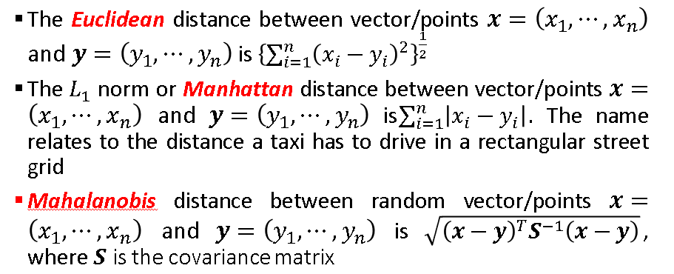
Cluster Analysis: Idea of distance Measure

Slide 37
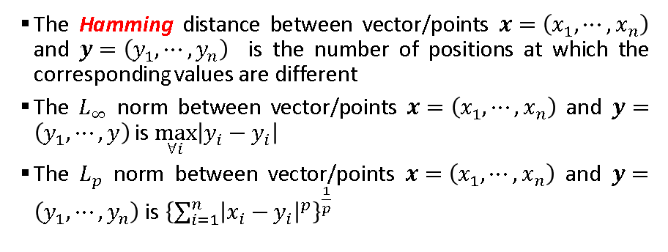
Cluster Analysis: Idea of distance Measure (contd…)

Slide 38
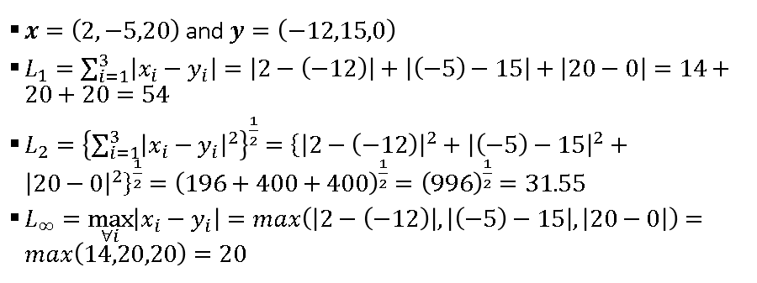
Cluster Analysis: Idea of distance Measure (contd…)

Slide 39
Cluster Analysis: Idea of distance Measure (contd…)

Slide 40
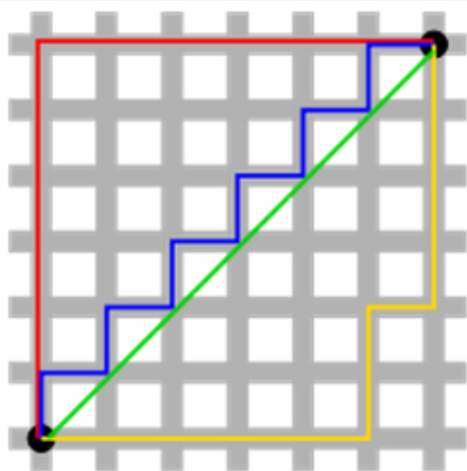
Cluster Analysis: Idea of distance Measure (contd…)

Slide 41
Cluster Analysis: Idea of distance Measure (contd…)
The green line (L₂-norm) is the unique shortest path, while the red, blue, yellow (L₁-norm) are all same length (=12) for the same route
This is why L₂-norm has unique solution while L₁-norm does not have any unique solution
One can generalize this to n-dimension case

Slide 42
Cluster Analysis: First Algorithm (Idea)
Basic K-mean algorithm: The K-mean clustering algorithm works on the premise that centroids of a group of objects best depict the characteristics of that group/cluster

Slide 43
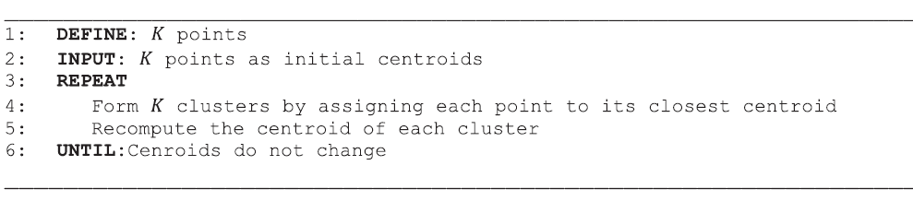
Cluster Analysis: First Algorithm (Idea) (Contd….)
Basic K-mean algorithm

Slide 44
Cluster Analysis: Second Algorithm (Idea)
Bisecting K-mean algorithm: The bisecting K-mean algorithm is a simple extension of the basis K-mean algorithm. The idea is to obtain K clusters and split the set of points into two clusters and then select one of them to split it again. We continue doing this until K clusters are obtained

Slide 45
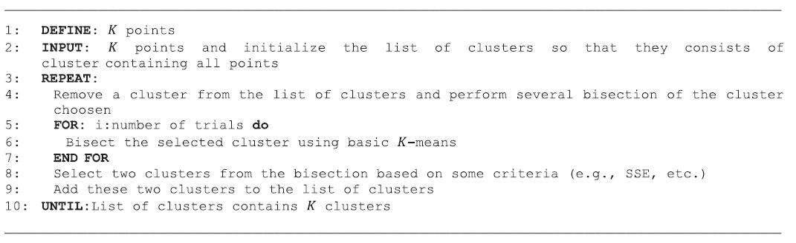
Cluster Analysis: Second Algorithm (Idea) (Contd….)
Bisecting K-mean algorithm

Slide 46
Cluster Analysis: Third Algorithm (Idea)
Basic agglomerative hierarchical clustering algorithm: It is a hierarchical clustering algorithm, whereby we start with points as individual clusters and at each step merge the closet pairs of clusters. Hence, a cluster proximity function is important, which needs to be defined before one ventures to use this clustering algorithm

Slide 47
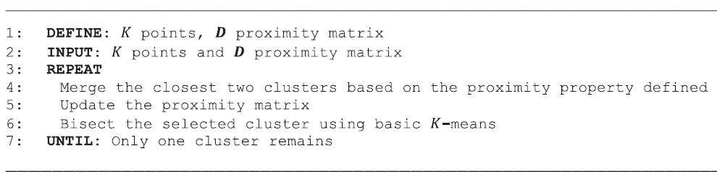
Cluster Analysis: Third Algorithm (Idea) (contd…)
Basic agglomerative hierarchical clustering algorithm

Slide 48
Cluster Analysis: Dendogram
Representing a tree and is frequently used in different contexts: (i) hierarchical clustering; (ii) computational biology; (iii) phylogenetics
Derives from the two ancient Greek words (déndron), meaning "tree", and (grámma), meaning "drawing, mathematical figure"

Slide 49
Cluster Analysis: Dendogram (contd….)

